Slide 1
Cross-sectional variation in the earnings response coefficient:
Current evidence from S&P500 companies
Bianca Minuth
3rd Assignment
Research on Corporate Transparency

Slide 2
Earnings Response Coefficient (ERC) & Estimation
Earnings Response Coefficient (ERC) measures the response of stock prices to earnings announcements and is the stock price change associated with an unexpected earnings change.
ERCs are expected to be an increasing function of the extent an earnings announcement results in a revision in expected earnings and a decreasing function of the expected rate of return.
CAR = a + bUX, + e; where CAR is a measure of risk-adjusted return for security i cumulated over period t, UX is a measure of unexpected earnings.
Sample: WRDS Data (Compustat, CRSP, I/B/E/S) from 11/2019 - 12/2020
Estimation:
Cumulative Abnormal Returns (CAR) around the earnings announcements (event date)
with a 3-day-window of CAR[-1;1]
with a 4-day-window of CAR[-3;0]
both with an estimation window of 250 trading days prior to the event date
S&P500 price change as a benchmark
Unexpected earnings as actual announced EPS minus analyst’s (first) estimation prior to the announcement

Slide 3
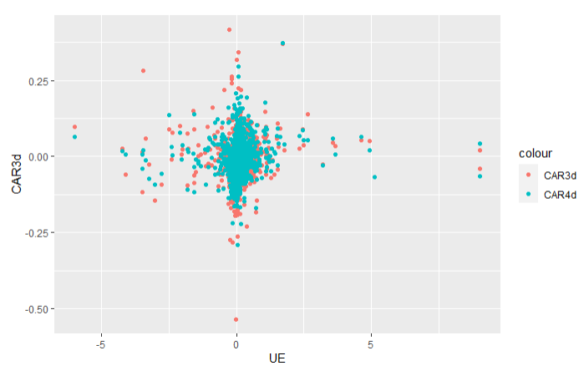
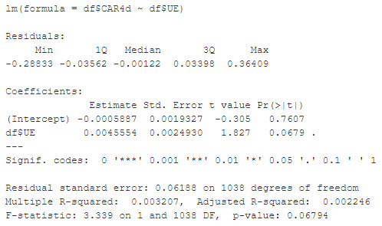
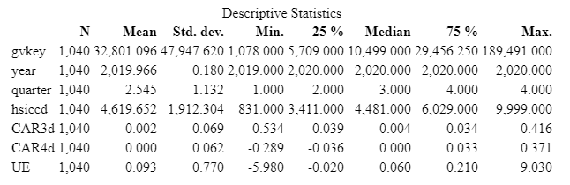
Figure I: Regression CARs and UE
Results (1/2)
Table I shows a positive ERC, statistically significant on a 10% level for CAR4d ~ UE.
CAR [-3;0] on a 4-day-window level turned out to be more representative, thus the following regression refers to CAR4d (refer to Table II).
Table II: Regression CAR4d and UE
Table 1: Descriptive statistics

Slide 4
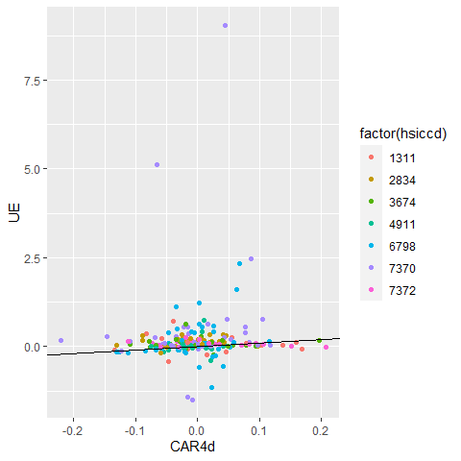
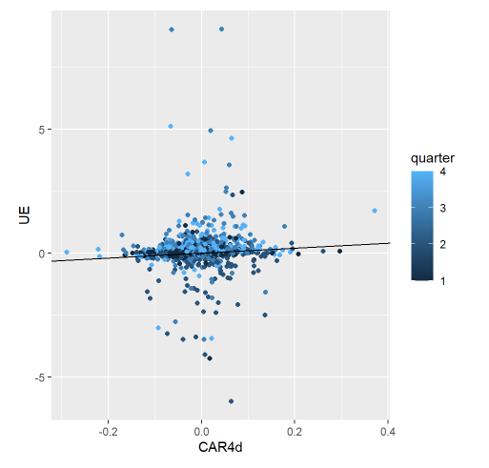
Results (2/2)
Figure II: Regression CAR4d and UE, highlighting the quarter
Figure III: Regression CAR4d and UE, showing the most represented sectors (hsiccd)
Figure II shows the sectors that were most represented in the dataset (No. of companies within sectors).
Plotting the regression of CAR4d and UE highlighting the different sectors and quarters, show a diverse picture which could explain the variation in ERC (Figure II+III).

Slide 5
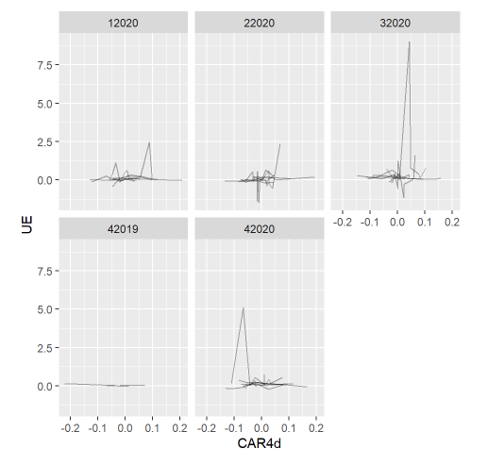
ERC cross-sectional interpretation & Limitations
Figure IV: Regression CAR4d and UE per quarter
ERC was shown to be an increasing function of the extent an earnings announcement results in a revision in expected earnings (sign: 10% level).
The variations might be explained by the differences between the sectors and quarters (see Figure IV).
Control variables only on a yearly basis possible due to data restrictions.
Other estimation windows might extent the robustness of the findings.
The cross-sectional variation with regard to industry or company size could be extended.

Slide 6
References
Bissessur, S. W., and Veenman, D. 2016. “Analyst Information Precision and Small Earnings Surprises.” Review of Accounting Studies 21 (4): 1327–60. https://EconPapers.repec.org/RePEc:spr:reaccs:v:21:y:2016:i:4:d: 10.1007_s11142-016-9370-2.
Collins, D. W., and Kothari, S. P. 1989. “An Analysis of Intertemporal and Cross-Sectional Determinants of Earnings Response Coefficients.” Journal of Accounting and Economics 11 (2): 143–81. https://doi.org/https://doi.org/10.1016/0165-4101(89)90004-9.
Easton, P. D., and Zmijewski, E. M. 1989. “Cross-Sectional Variation in the Stock Market Response to Accounting Earnings Announcements.” Journal of Accounting and Economics 11 (2): 117–41. https://doi.org/https://doi.org/10.1016/0165-4101(89)90003-7.
Kothari, S. P., Sloan, R. G. 1992. “Information in prices about future earnings: Implications for earnings response coefficients.” Journal of Accounting and Economics 15 (2-3): 143-171. https://doi.org/10.1016/0165-4101(92)90016-U
Teets, W. R., and Wasley., C. E. 1996. “Estimating Earnings Response Coefficients: Pooled Versus Firm-Specific Models.” Journal of Accounting and Economics 21 (3): 279–95. https://EconPapers.repec.org/RePEc:eee:jaecon:v:21:y:1996:i:3:p: 279-295.

